Slide 1
Digital Portfolio
STUDENT NAME: R.PAVITHRA
REGISTER NO AND NMID:
DEPARTMENT:COMPUTER SCIENCE
COLLEGE: COLLEGE/ UNIVERSITY SREE ABIRAAMI ARTS AND SCIENCE COLLEGE FOR WOMEN,GUDIYATHAM FROM THIRUVALLUR UNIVERSITY.

Slide 2
PROJECT TITLE
🎨 Design & Creative Projects

Slide 3


AGENDA
Problem Statement
Project Overview
End Users
Tools and Technologies
Portfolio design and Layout
Features and Functionality
Results and Screenshots
Conclusion
Github Link
3/21/2024 Annual Review

Slide 4

PROBLEM STATEMENT
"Modern portfolios often lack personalization, clarity, and strategic alignment. This project aims to design a dynamic, user-centric portfolio that effectively showcases skills, achievements, and goals while enhancing visibility, engagement, and professional impact across digital platforms."

Slide 5

PROJECT OVERVIEW
"This portfolio showcases a curated selection of my creative and technical projects, reflecting my skills in design, development, and problem-solving. Each piece highlights innovation, attention to detail, and a commitment to excellence. From concept to execution, this collection represents my journey, growth, and passion for delivering impactful solutions across diverse domains."

Slide 6

WHO ARE THE END USERS?
The end users of a portfolio include potential employers, clients, investors, collaborators, and academic institutions. They review the portfolio to assess skills, experience, and achievements, helping them make informed decisions about hiring, partnerships, funding, or admissions.

Slide 7

TOOLS AND TECHNIQUES
Tools and techniques for portfolio development include SWOT analysis, SMART goal setting, time management apps, visual design software, and reflective journaling. These help organize achievements, showcase skills, and track growth. Using templates, feedback loops, and digital platforms enhances presentation and clarity, making your portfolio both professional and personally meaningful.

Slide 8
POTFOLIO DESIGN AND LAYOUT
A well-crafted portfolio design blends creativity with clarity. Use clean layouts, consistent typography, and a cohesive color scheme to reflect your personal brand. Highlight key projects with visuals and concise descriptions. Prioritize user-friendly navigation and responsive design. Let your portfolio tell your story—professionally, aesthetically, and memorably.
8

Slide 9
FEATURES AND FUNCTIONALITY
Showcase your skills with a dynamic portfolio featuring responsive design, interactive galleries, project highlights, and downloadable resumes. Integrate contact forms, social media links, and real-time updates. Customizable layouts and smooth navigation ensure a professional user experience. Perfect for freelancers, creatives, and professionals aiming to impress and connect effortlessly.

Slide 10
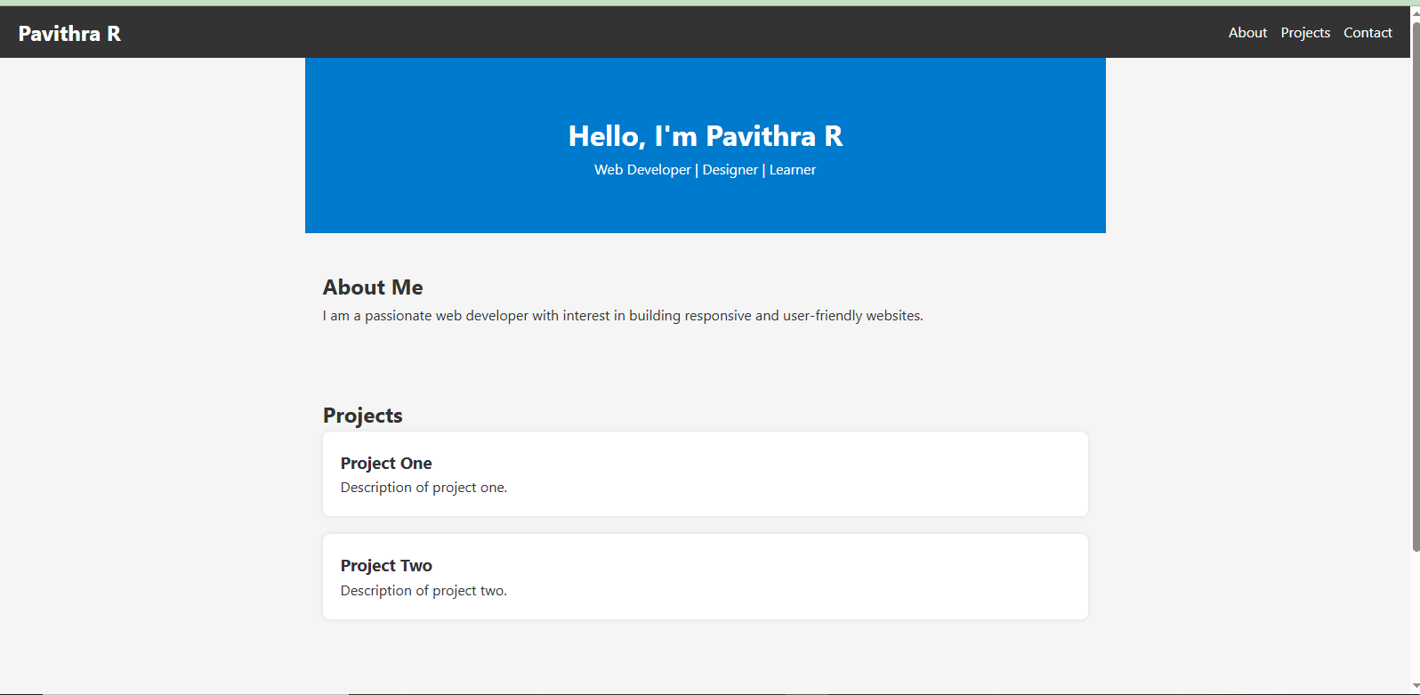
RESULTS AND SCREENSHOTS
10

Slide 11
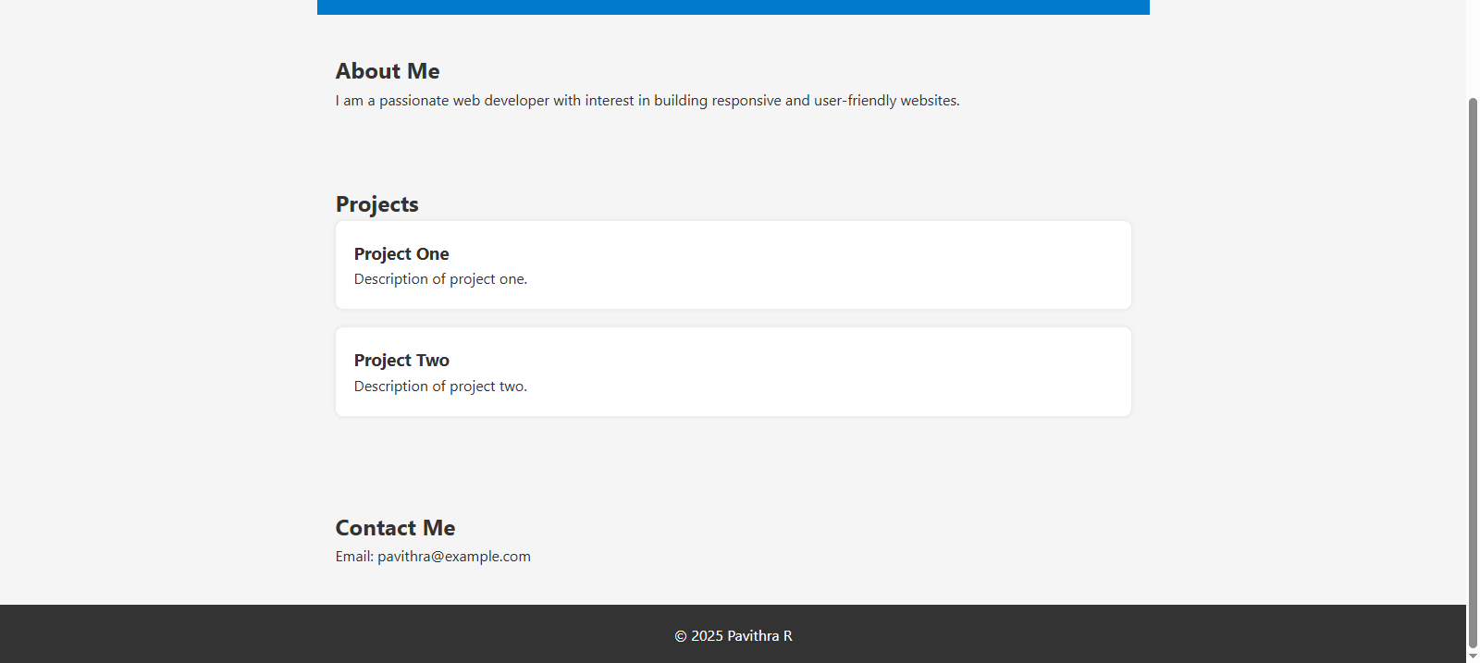

Slide 12
CONCLUSION
This portfolio reflects my journey of growth, creativity, and dedication. Each piece showcases my evolving skills and passion for excellence. Through challenges and exploration, I’ve gained valuable insights and developed a deeper understanding of my craft. I look forward to future opportunities where I can continue to learn, contribute, and innovate. Thank you for taking the time to explore my work—it truly means a lot.
12

